Slide 1

NOVEMBER 2025 |
ANALYZING BOOKING TRENDS IN THE HOSPITALITY INDUSTRY
A Machine Learning Approach to Predicting Booking Cancellations
Tools Used: Python (Pandas, Seaborn, Scikit-Learn), Excel, Matplotlib
BY: HOLINESS SEGUN-OLUFEMI

Slide 2

  The hospitality industry faces high booking cancellation rates, which affects revenue and resource planning.
  Understanding customer behavior can help hotels anticipate cancellations and take proactive action.
  The goal: Predict whether a booking will be canceled based on customer and booking characteristics.
BACKGROUND AND OBJECTIVE
This project explores how data can be used to forecast booking outcomes, identify key factors behind cancellations, and recommend strategies for improving retention and operations.

Slide 3

ABOUT
THE DATASET
The dataset includes over 30,000 booking records, covering a range of guest demographics and booking behaviors across multiple channels.
  Total records: ~36,000 bookings
  Time period: 2015–2018
  Key features:
    Lead time (days before booking)
    Market segment (Online, Offline, etc.)
    Booking status (Canceled / Not Canceled)

Slide 4
DATA PREPROCESSING STEPS
  Removed unnecessary data features
  Exploratory Data Analysis
  Encoded categorical features using LabelEncoder & scaling
  Standardized numeric columns (lead time, price) and splitting data
  Model testing and training, feature importance

Slide 5
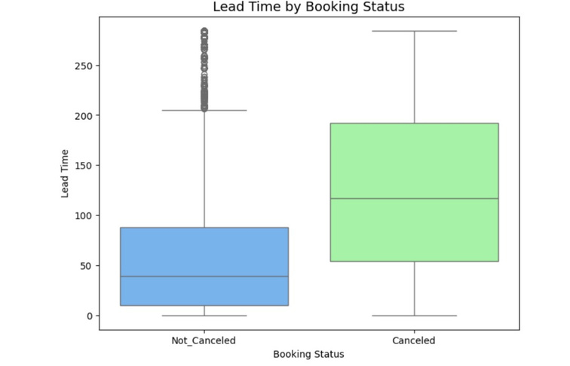
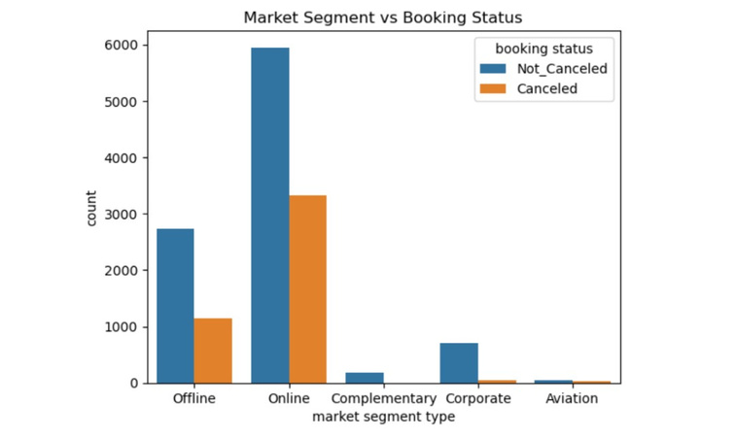

EXPLORING BOOKING BEHAVIOR
  Countplot: Booking status distribution
  Boxplot: Lead time vs Booking Status
  Barplot: Market segment vs Cancellation

Slide 6
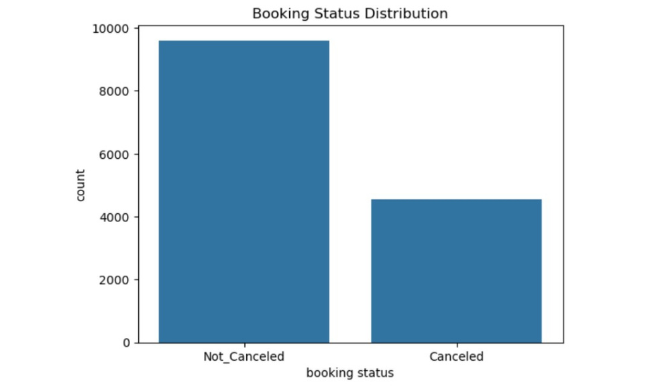
EXPLORING BOOKING BEHAVIOR
EDA revealed several interesting trends:
  Bookings with longer lead times were more likely to be canceled.
  Online bookings showed higher cancellation rates than offline ones.
  Customers with special requests tended to keep their reservations.

Slide 7
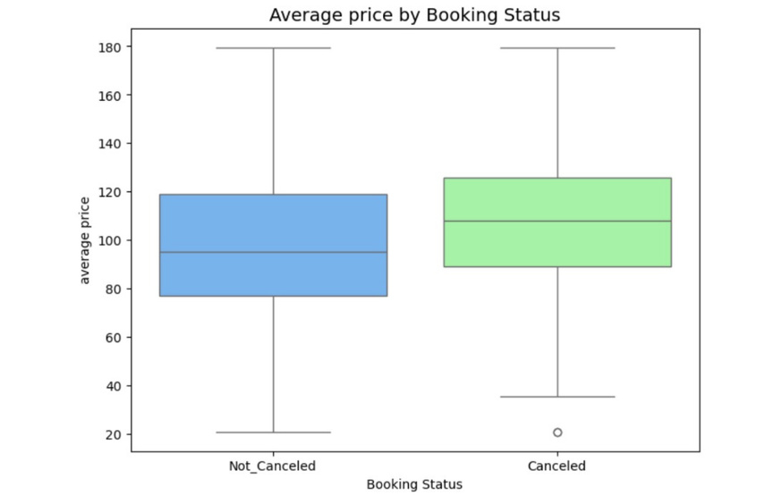
Top 5 Insights:
  Longer lead times → higher cancellation probability.
  Online bookings are twice as likely to cancel as offline ones.
  Higher average room price slightly correlates with cancellation (likely price sensitivity).
  Repeated customers have the lowest cancellation rate.
INSIGHTS FROM THE DATA
These findings help us understand customer intent and booking reliability — critical for revenue forecasting and customer management.

Slide 8
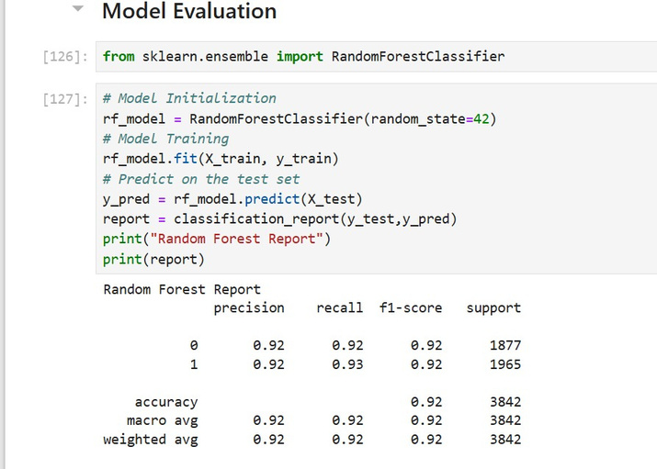

MACHINE LEARNING MODEL
  Target Variable: booking_status
  Algorithms Tested: Logistic Regression, Decision Tree, Random Forest
  Final Model: Random Forest Classifier
  Accuracy: ~92% on test data
Several models were trained and selected Random Forest for its balance between accuracy and interpretability. It achieved about 92% accuracy, meaning the model could correctly predict most cancellation outcomes.

Slide 9

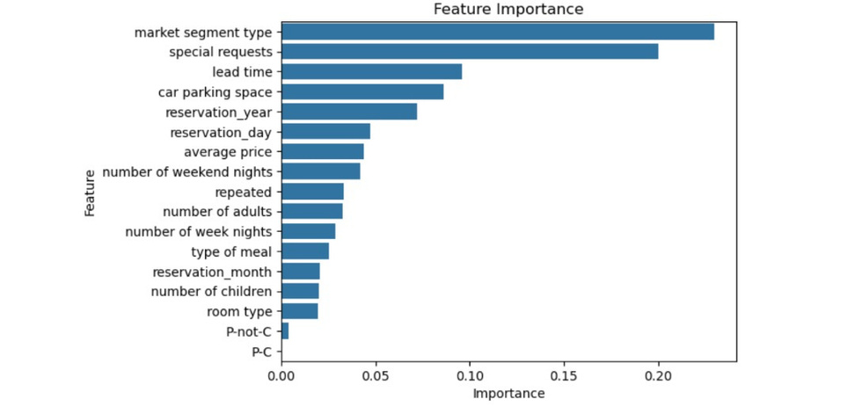

WHAT FACTORS MATTER MOST?
  Market Segment Type
  Special Requests
  Lead Time
  Car Parking Space
  Reservation for the Year
The top predictors of cancellation were marketing, customer intent, and timing to drive most booking behaviours — confirming our earlier insights.

Slide 10

RECOMMENDATIONS FOR THE HOTEL INDUSTRY
  Encourage short lead time bookings with limited-time offers.
  Reward repeated customers with loyalty discounts — they rarely cancel.
  Monitor high-risk online bookings and confirm via reminders or deposits.
  Promote special request options (e.g., meal plans) — they signal higher commitment.
  Use predictive analytics regularly to forecast occupancy rates.
By using this model, hotels can predict cancellations in advance and adjust pricing, marketing, and inventory accordingly.

Slide 11
CONCLUSION AND NEXT STEPS
  Data-driven models can enhance hotel efficiency and customer engagement.
  Future work could include:
    Dynamic pricing models
    Sentiment analysis on customer reviews
    Integration with booking APIs for real-time prediction
In conclusion, this project shows how analytics can strengthen decision-making in hospitality — turning uncertainty into strategy.

Slide 12

THANK YOU.

